Slide 1


YENEPOYA INSTITUTE OF TECHNOLOGY
NH-13, THODAR, MOODBIDRI, DAKSHINA KANNADA-574225
2025-26
Department of Information Science and Engineering
Mini Project Presentation on
“Developing XLM-RoBERTa Sentiment Analysis Model for Kannada: Addressing Low-Resource Language”
PRESENTED BY :
NAVEEN KATTI (4DM23IS031)
NIKITH N (4DM23IS032)
PREM GOUDA (4DM23IS035)
SUMANTH T P (4DM23IS056)
UNDER THE GUIDANCE OF
Prof. Manish Prajapati
Assistant Professor
Dept.of ISE

Slide 2
Table of contents
Abstract
Introduction
Literature Survey
Problem Statement
Application
Methodology
System Requirements
Proposed System
Key features & Innovations
Flow Diagram
Results & Snapshot’s
conclusion
Future Works
Reference

Slide 3

Abstract
The project implements Emotion Recognition in Kannada using advanced Deep Learning techniques.
Emotions identified: Joy, Anger, Sadness, Fear, and Neutral.
Methodology: Utilized XLM-RoBERTa, a cross-lingual transformer model, fine-tuned on a balanced dataset of ~10,000 sentences.
Key Techniques: Employed keyword-based augmentation to improve detection of short, colloquial phrases.
Deployment: Integrated the model into a Flask web application for real-time user interaction and prediction.
Performance: Achieved high accuracy and robust performance across both long and short text inputs.
Future Scope: Expand dataset for dialect variations and include more complex emotion categories.

Slide 4
Introduction
Emotion Recognition is a key component of Natural Language Processing (NLP) for understanding human sentiment in text.
Problem Statement: Most NLP research focuses on English, leaving Indian languages like Kannada under-represented (low-resource).
Challenge: Lack of robust datasets and pre-trained models specifically designed for Kannada's complex morphology.
Proposed Solution: We leverage XLM-RoBERTa, a state-of-the-art multilingual transformer, to bridge this gap.
Core Objective: To build an accurate, real-time system capable of classifying Kannada text into Joy, Anger, Sadness, Fear, and Neutral.
Applications: Useful for analyzing social media sentiment, customer feedback, and mental health monitoring in regional languages.

Slide 5
Literature Survey
Reference | Project Relevance
Prof. Sushma T. M. et al. (2025) “Sentimental Analysis of Kannada Product Review Using BERT” | High accuracy for Kannada sentiment; useful for real‑time NLP.
K. P. Suprith Patil et al. (2024) “Sentiment Analysis in Indian Regional Language (Kannada)” | Supports multi‑emotion Kannada analysis and preprocessing pipelines.
Shashirekha H. L. et al. (2022) “ML Approaches for Code‑Mixed Kannada-English Text Identification” | Helps handle Kannada‑English mixed text for social media NLP.
Gazi Imtiyaz Ahmad et al. (2022) “ML Techniques for Sentiment Analysis of Code‑Mixed Text” | Provides ML/NLP technique comparisons for code‑mixed data.
Mariana Purba et al. (2022) “Effect of Random Splitting & Cross‑Validation” | Shows need for proper validation for reliable sentiment/emotion models.
Alebachew Chiche & Betselet Yitagesu (2022) “Review of ML/DL POS Tagging” | Improves text preprocessing quality for downstream NLP tasks.
Ramesh Chundi et al. (2020) “Sentiment Analysis for Code‑Switch Kannada Text” | Demonstrates deep learning for Kannada code‑switch; motivates multilingual models.

Slide 6
Problem Statement
English Bias: Most current AI tools only understand English well and fail with regional languages like Kannada.
Lack of Data: There isn't enough high-quality data available to teach computers how to understand Kannada emotions.
Complex Grammar: Kannada is a complex language, and simple translation methods often get the meaning wrong.
Lost in Translation: Converting Kannada to English for analysis loses the true feeling and cultural context of the message.
The Need: We need a specific tool built for Kannada to accurately understand the feelings of millions of native speakers.
Department of ISE

Slide 7
Application
Social Media Monitoring: Automatically tracking public sentiment and trends on platforms like Twitter and Facebook by analyzing Kannada posts and comments.
Customer Feedback Analysis: Helping businesses understand customer satisfaction by classifying reviews and support tickets into emotions like Anger (complaints) or Joy (praise).
Mental Health Support: Early detection of distress or depression signals in chat logs and digital journals to trigger timely interventions.
Content Moderation: Identifying and filtering out toxic, aggressive, or hateful content (Anger/Fear) in online communities and forums.
Personalized Recommendations: Tailoring content (news, music, videos) based on the user's detected emotional state to improve engagement.

Slide 8
Methodology
Data Collection: Curated a balanced dataset of 10,000 Kannada sentences, distributed equally across 5 emotion classes (2,000 per class).
Preprocessing: Applied text cleaning to remove noise (e.g., Zero Width Joiners) and tokenized inputs using the XLM-RoBERTa tokenizer.
Data Augmentation: Implemented keyword-based augmentation to generate synthetic short sentences, addressing model bias and improving robustness on brief inputs.
Model Architecture: Fine-tuned the XLM-RoBERTa (Base) transformer model, leveraging its cross-lingual capabilities for effective feature extraction.
Training Strategy: Trained for 3 epochs using the AdamW optimizer and a linear learning rate scheduler to ensure stable convergence.
Evaluation: Assessed performance using Accuracy, F1-Score, and Confusion Matrices to verify precision across all emotion categories.
Deployment: Built a lightweight Flask web interface to demonstrate real-time emotion prediction on user inputs.

Slide 9
System Requirements
Hardware requirements:
Processor (CPU): Intel Core i5 (8th Gen) or AMD Ryzen 5 equivalent (Minimum).
Memory (RAM): 8 GB Minimum (16 GB Recommended for smoother training).
Storage: 10 GB free disk space (for dataset, model weights, and dependencies).
Graphics Processing Unit (GPU): NVIDIA GPU with at least 4GB VRAM (Recommended for faster training/inference), though CPU-only execution is supported.
Internet Connection: Required for downloading pre-trained models and libraries

Slide 10
Software Requirements
Operating System: Windows 10/11, Linux (Ubuntu 20.04+), or macOS.
Programming Language: Python 3.8 or higher.
Deep Learning Framework: PyTorch (v1.10+).
Libraries: Hugging Face Transformers, Scikit-learn, NumPy, Pandas.
Web Framework: Flask (for backend API and deployment).
IDE: VS Code, PyCharm, or Jupyter Notebook.

Slide 11
Proposed System
XLM-Roberta (Cross-lingual Language Model - RoBERTa) is a transformer-based multilingual model developed by Facebook AI (Meta). It is pre-trained on a massive dataset comprising 2.5 terabytes of filtered CommonCrawl data across 100 different languages, making it one of the most powerful models for cross-lingual understanding.

Slide 12
Key Features & Innovations
Massive Multilingual Training: Unlike previous models trained on Wikipedia, XLM-R is trained on CommonCrawl data, significantly increasing the amount of data for low-resource languages like Kannada.
Unified Vocabulary: It uses a large shared vocabulary (250k tokens) via SentencePiece, allowing it to handle multiple languages and scripts without needing language-specific preprocessing.
RoBERTa Architecture: It builds on the robust RoBERTa approach (Robustly optimized BERT approach), which removes the Next Sentence Prediction (NSP) task and trains on longer sequences for better performance.
No Language Embeddings: Unlike XLM, it does not use specific language embeddings, allowing the model to learn language representations directly from the text data.

Slide 13
Benefits
Superior Performance: It consistently outperforms multilingual BERT (mBERT) on cross-lingual classification tasks, especially for low-resource languages.
Cross-Lingual Transfer: It can learn a task in one language (e.g., English) and apply it to another (e.g., Kannada) with minimal additional training.
Robustness: The model is highly effective at handling noisy text and diverse linguistic structures, which is crucial for real-world social media or customer support data.
Democratization of NLP: It enables high-quality NLP tools for regional languages (like Kannada) that were previously underserved by major tech advancements.
Reduced Data Dependency: It reduces the need for massive labeled datasets in every target language, as the model already understands the underlying structure of the language.
Global Scalability: Developers can build a single model that serves users across dozens of languages, simplifying deployment and maintenance.
Implications

Slide 14
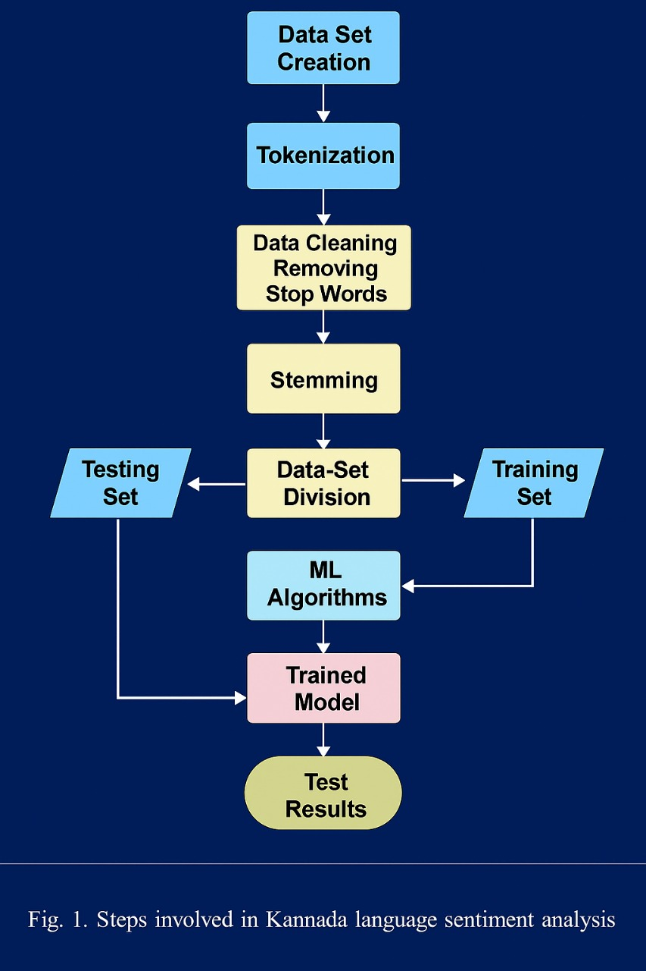




Flow diagram

Slide 15
Results
Accuracy: The model achieved an accuracy of ~99% on the test dataset.
Robustness: Successfully classifies short phrases (e.g., "ನನಗೆ ಖುಷಿ") and complex sentences.

Slide 16
Comparison of Proposed Model with other Models
Model | Final Validation Loss | Final Validation Accuracy | Test Loss | Test Accuracy | Softmax Probability Example | Confusion-Related Evaluation
CNN | 2.29 × 10⁻⁹ | 93% | 2.29 × 10⁻⁹ | 93% | ≈0.9 for all classes | Minor confusion
BiLSTM | 0.0650 | 94.79% | 0.1025 | 94.79% | High confidence | Minor confusion (not reported)
GRU | 0.8816 | 73.13% | 0.8816 | 73.13% | Moderate confidence | High confusion between classes
DistilBERT | 0.4161 | 87.42% | 0.3929 | 87.42% | joy: 0.9974, anger: 0.6154 | Moderate confusion
XLM-RoBERTa-Base (Proposed Model) | 0.0001 (val) | 99.3% | 0.0003 | 99.3% | Very high stability (F1 = 1.0) | Perfect confusion matrix – zero errors

Slide 17
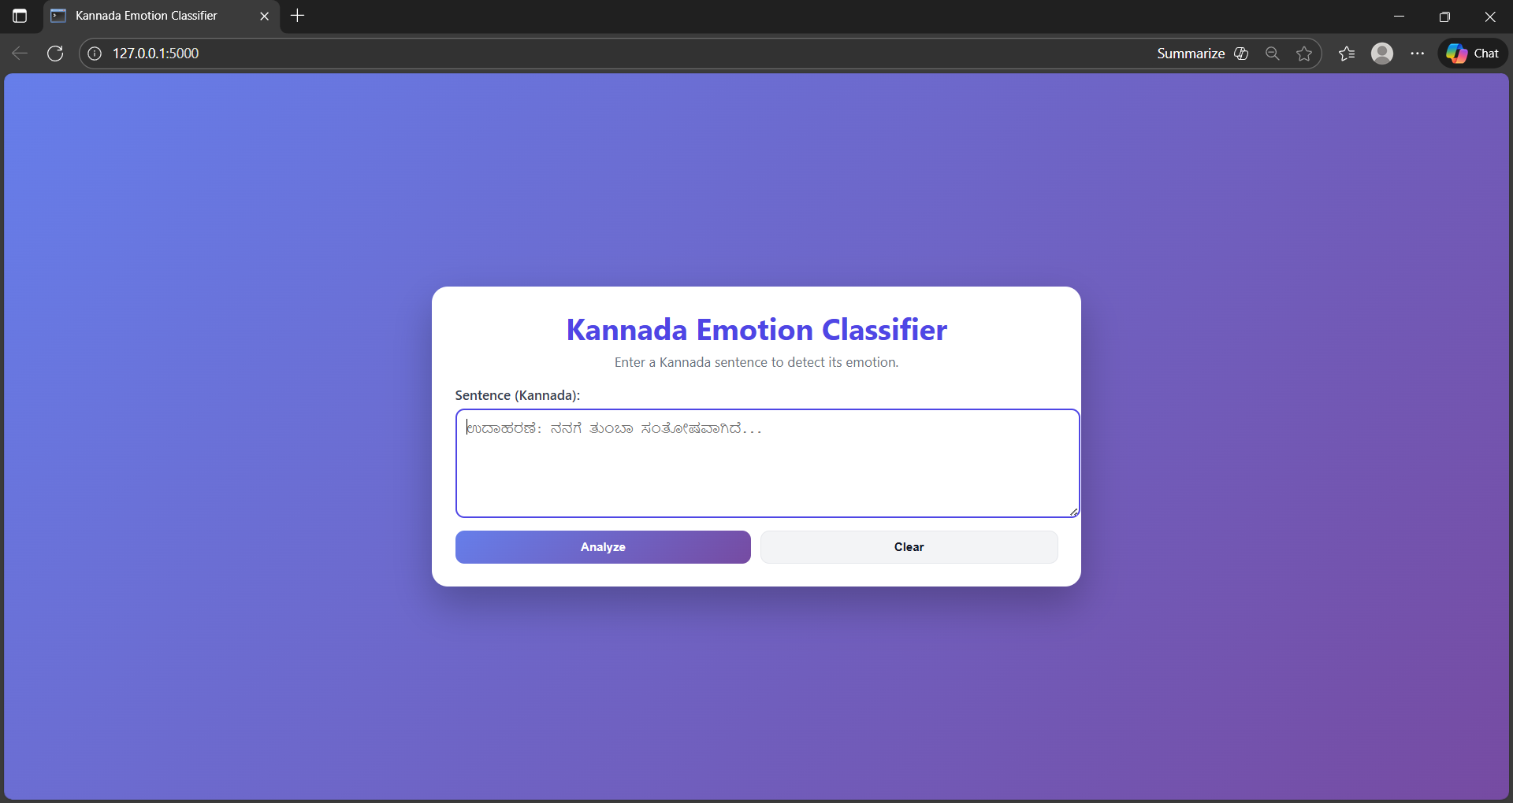
Snapshot’s

Slide 18
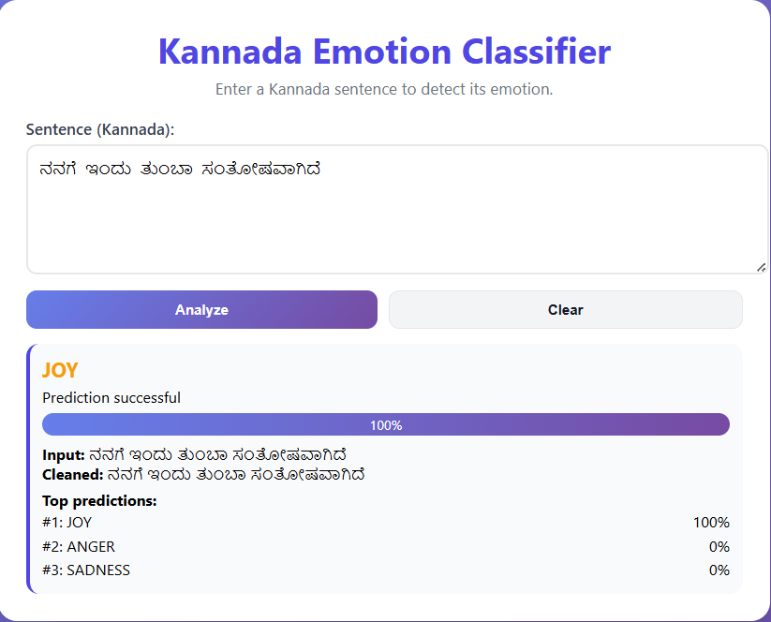
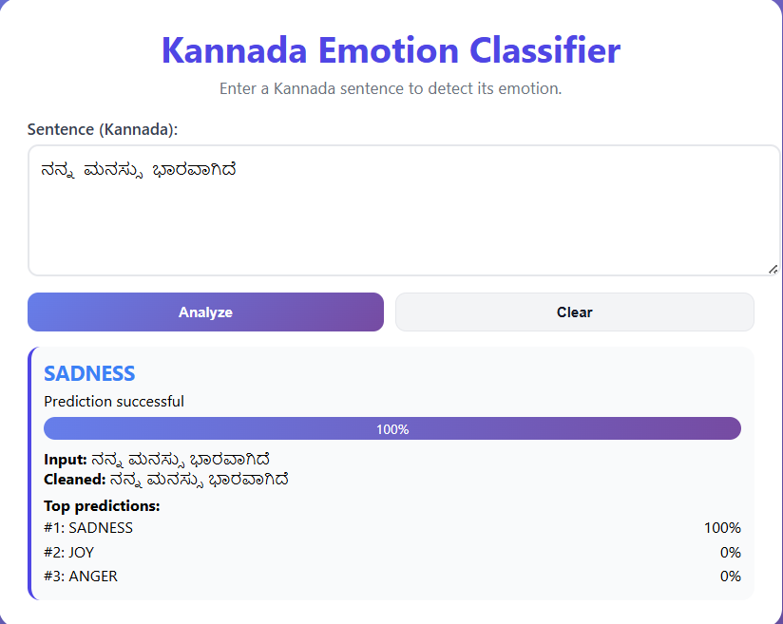

Slide 19
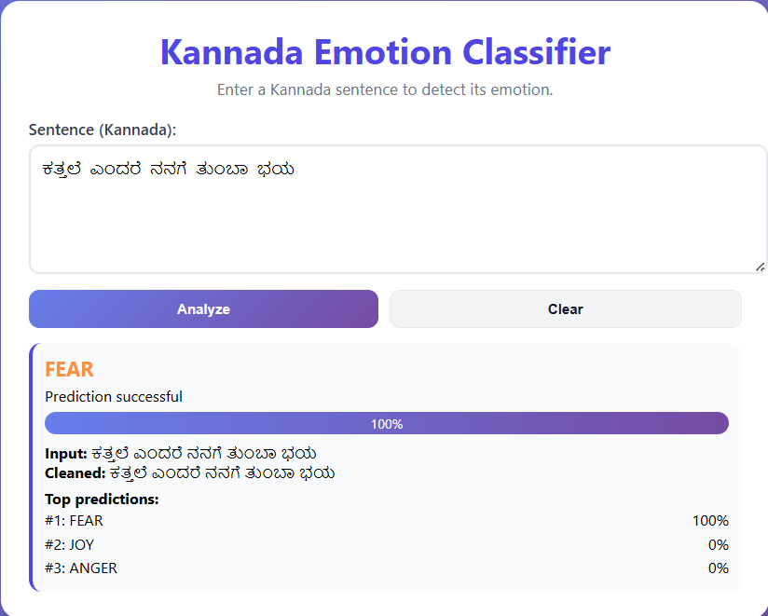
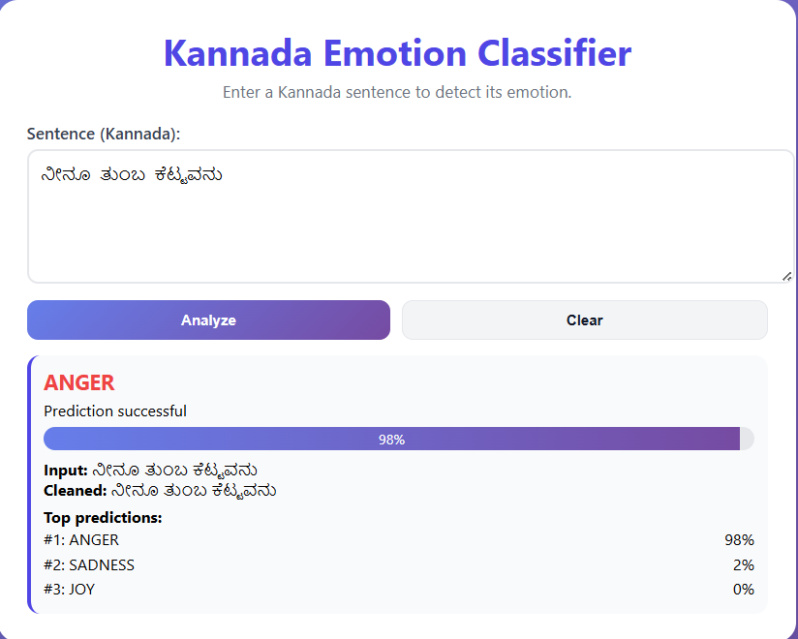

Slide 20
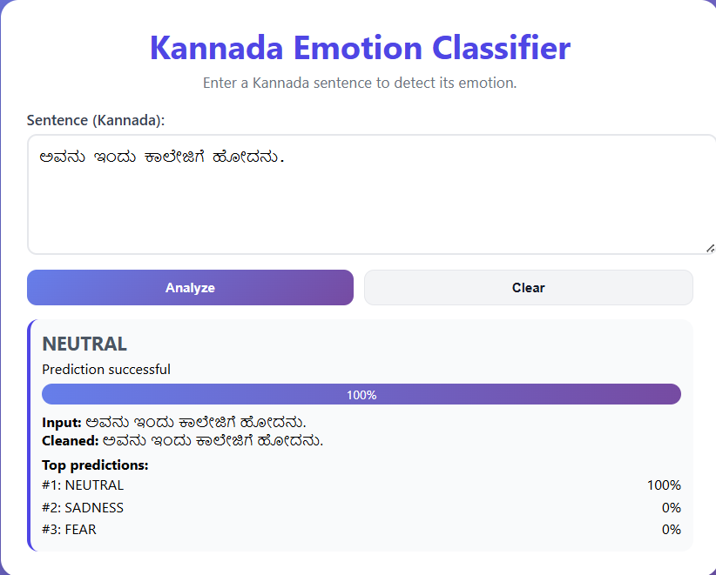

Slide 21
Conclusion
Successfully Built: We created a working AI model that can accurately detect emotions (Joy, Anger, Sadness, Fear, Neutral) in the Kannada language.
Overcame Language Barrier: By using advanced technology (XLM-RoBERTa), we proved that computers can understand regional Indian languages just as well as English.
Real-World Use: The system is fast and ready to be used in real apps, like analyzing customer feedback or monitoring social media in Karnataka.
Simple & Effective: Even with short, everyday words, the model performs well, making it practical for real conversations.
Step Forward: This project is a significant step towards making technology more inclusive and accessible for Kannada speakers.

Slide 22
Future Works
Expand Emotion Categories: Add more subtle emotions like "Surprise," "Disgust," or "Trust."
Speech-to-Text Integration: Allow users to speak in Kannada, convert it to text, and then analyze the emotion.
Mobile Application: Develop a dedicated Android/iOS app for on-the-go usage.
Mixed-Code Support: Improve handling of "Kanglish" (Kannada written in English script) or sentences mixing English and Kannada words.
Large Scale Deployment: Deploy the API on cloud platforms (AWS/GCP) for public access.

Slide 23
Reference
Sushma T. M., Sudeep T. C., Kiran J. Marati, N. Sneha Reddy, and Rakesh V., “Sentimental Analysis of Kannada Product Review Using BERT,” International Research Journal of Engineering and Technology (IRJET), vol. 12, no. 2, pp. 79–83, Feb. 2025
K. P. S. Patil, A. D., K. Kishan, B. G., and A. Venkatesh, “Sentiment Analysis in Indian Regional Language (Kannada),” in 2024 Third International Conference on Artificial Intelligence, Computational Electronics and Communication System (AICECS), IEEE, 2024P.A.Dhulekar,PriyankaAher,YogitaKhairnar,Swapnali Choudhari “Design of IR based Image Processing Technique for Digital Camera Deactivation” presented in IEEE International Conference on Global Trends in Signal Processing, Information Computing and Communication 2016.
S. H. Lakshmaiah, F. Balouchzahi, M. D. Anusha, and G. Sidorov, “CoLI-Machine Learning Approaches for Code-mixed Language Identification at the Word Level in Kannada-English Texts,” Acta Polytechnica Hungarica, vol. 19, no. 10, pp. 123–141, 2022.

Slide 24
Purba, M., Ermatita, E., Abdiansah, A., Noprisson, H., Ayumi, V., Salamah, U., Setiawan, H., & Yadi, Y. (2022). Effect of random splitting and cross validation for Indonesian opinion mining using machine learning approach. International Journal of Advanced Computer Science and Applications (IJACSA), 13(9), 145–151. https://doi.org/10.14569/IJACSA.2022.0130918
Ramesh Chundi and Vishwanath R. Hulipalled. "SAEKCS: Sentiment Analysis for English - Kannada Code Switch Text Using Deep Learning Techniques." International Conference on Smart Technologies in Computing, Electrical and Electronics (ICSTCEE), 2020.
G. I. Ahmad, J. Singla, A. Ali, A. A. Reshi, and A. A. Salameh, “Machine Learning Techniques for Sentiment Analysis of Code-Mixed and Switched Indian Social Media Text Corpus: A Comprehensive Review,” International Journal of Advanced Computer Science and Applications (IJACSA), vol. 13, no. 2, pp. 455-467, 2022

